Slide 1
Azure Durable Functions
Nick Raphael
email: nick.raphael@gmail.com
twitter: @nick_raphael
github: https://github.com/nickraphael
slides: ????????

Slide 2
Regular Azure Functions
Serverless
Choice of language: C#, Javascript, F#, Java, Powershell, Python, Typescript
Small units of code / functionality
Autoscaling
Pay-per-use pricing model
Input / output binding

Slide 3
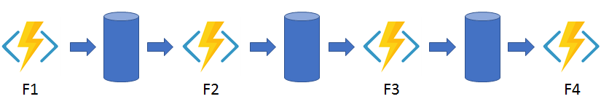
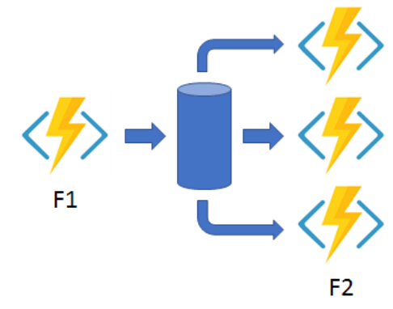
Typical examples using azure functions
Function chaining:
Function fan out:

Slide 4
So what’s wrong with regular azure functions?
Function chaining:
How do we get progress status?
How do we cancel the flow? Restart flow on error?
The logic of the work flow is distributed across our app. Logic of workflow is not centralised.
Fan out:
How do we get progress status?
How do we cancel the flow? Restart flow on error?
How do we fan-in and continue the flow?

